Slide 1
E-Commerce and Technologies
B2B E-commerce: Supply Chain Management and Collaborative Commerce

Slide 2
Objectives
Define B2B commerce and explain its scope and history.
Explain the procurement process, the supply chain, and collaborative commerce.
Identify the main types of B2B commerce: Net marketplaces and private industrial networks.
Identify the role of private industrial networks in transforming the supply chain.

Slide 3
Trends in B2B E-commerce
Firms more comfortable with Internet security, payments, helping expand use of B2B channels
Growing realization that most important benefits are not low costs of materials, but gains in supply chain efficiency, better spend management, improved business process
Decline of independent Net marketplaces
Rapid growth in collaborative commerce B2B applications based on private networks
Continued consolidation in Net marketplace and software vendor markets

Slide 4
Defining B2B Commerce
Before Internet:
B2B transactions called trade or procurement process
Total inter-firm trade:
Total flow of value among firms
B2B commerce:
All types of computer-enabled inter-firm trade
B2B e-commerce:
The portion of B2B commerce enabled by the Internet

Slide 5
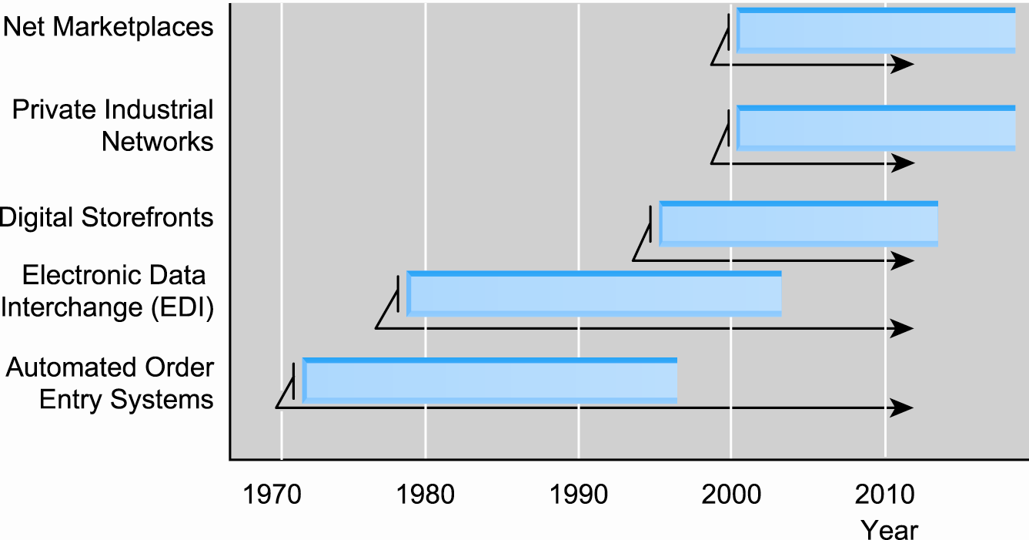
Evolution of the Use of Technology Platforms in B2B Commerce

Slide 6
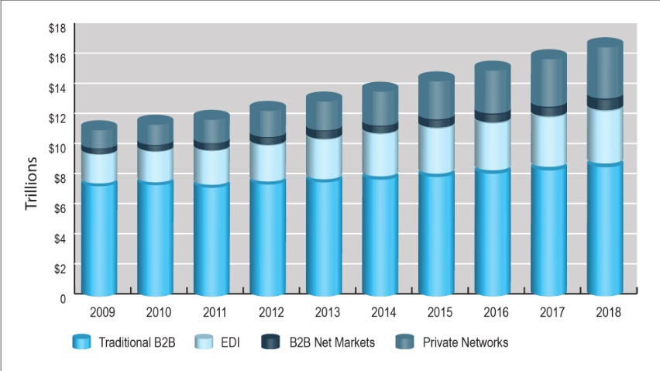
Growth of B2B Commerce 2002–2013

Slide 7
Industry Forecasts
Not all industries similarly affected by B2B e-commerce
Not all industries would benefit equally
Factors influencing move to e-commerce
Significant utilization of EDI
Large investments in IT and Internet infrastructure
E.g., aerospace and defense, computer, and industrial equipment industries
Market concentrated on purchasing and/or selling
E.g., energy, chemical industries

Slide 8
Potential Benefits of B2B E-commerce
Lower administrative costs
Lower search costs for buyers
Reduced inventory costs
Increasing competition among suppliers (increasing price transparency)
Reducing inventory carried
Lower transaction costs:
Eliminating paperwork
Automating parts of procurement process

Slide 9
Potential Benefits
Increased production flexibility by ensuring just-in-time parts delivery
Improved quality of products by increasing cooperation among buyers and sellers
Decreased product cycle time by sharing of designs and production schedules
Increased opportunities for collaborating with suppliers and distributors
Greater price transparency

Slide 10
The Procurement Process and the Supply Chain
Procurement process:
The way firms purchase materials they need to make products
Supply chain:
Firms that purchase goods, their suppliers, and their suppliers’ suppliers, and relationships and processes involved
Steps in procurement process:
Deciding who to buy from and what to pay
Completing transaction

Slide 11
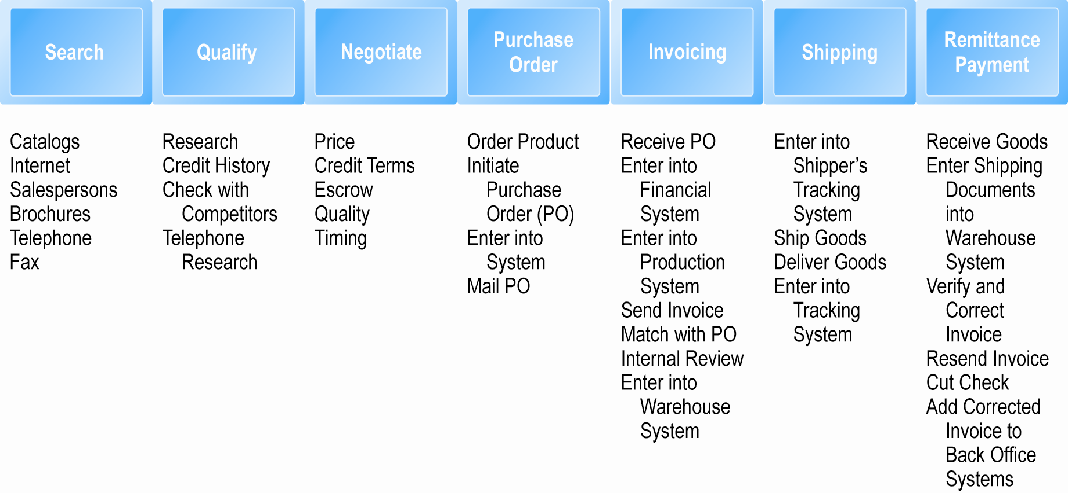
The Procurement Process

Slide 12
Types of Procurement
Firms purchase two types of goods
Direct goods: integrally involved in production process
Indirect goods: all goods not directly involved in production process (MRO goods)
Firms use two methods to purchase
Contract purchasing:
Involves long-term written agreements to purchase specified products, with agreed-upon terms and quality
Spot purchasing:
Involves purchase of goods based on immediate needs in larger marketplaces that involve many suppliers

Slide 13
Types of Procurement
Procurement is highly information intensive and labor intensive—3.3 million U.S. workers
Use of Internet can simplify process and reduce search, research, negotiating costs
Multi-tier supply chain
Complex series of transactions between firm and thousands of suppliers

Slide 14
The Role of Existing Legacy Computer Systems
Legacy computer systems
Generally older mainframe and minicomputer systems used to manage key business processes within firm
MRP systems (materials requirements planning)
Enable firms to predict, track, and manage parts of complex manufactured goods
ERP systems (enterprise resource planning)
More sophisticated MRP systems that include human resources and financial components

Slide 15
Trends in Supply Chain Management and Collaborative Commerce
Supply chain management (SCM):
Wide variety of activities that firms and industries use to coordinate key players in their procurement process
Major developments in SCM
Supply chain simplification
Electronic data interchange
Supply chain management systems
Collaborative commerce

Slide 16
Supply Chain Simplification
Essential for just-in-time production models
Typically achieved by:
Working with strategic group of suppliers to reduce product and administrative costs, while improving quality
Purchasing under long-term contracts that contain specified quality, cost, and timing goals
May involve
Joint product development and design
Integration of computer systems
Tight coupling

Slide 17
Electronic Data Interchange (EDI)
Broadly defined communications protocol for exchanging documents among computers
Stage 1: 1970s–1980s
Document automation
Stage 2: Early 1990s
Document elimination
Stage 3: Mid-1990s
Move toward continuous replenishment/access model
Today:
EDI provides for exchange of critical business information between computer applications supporting wide variety of business processes

Slide 18
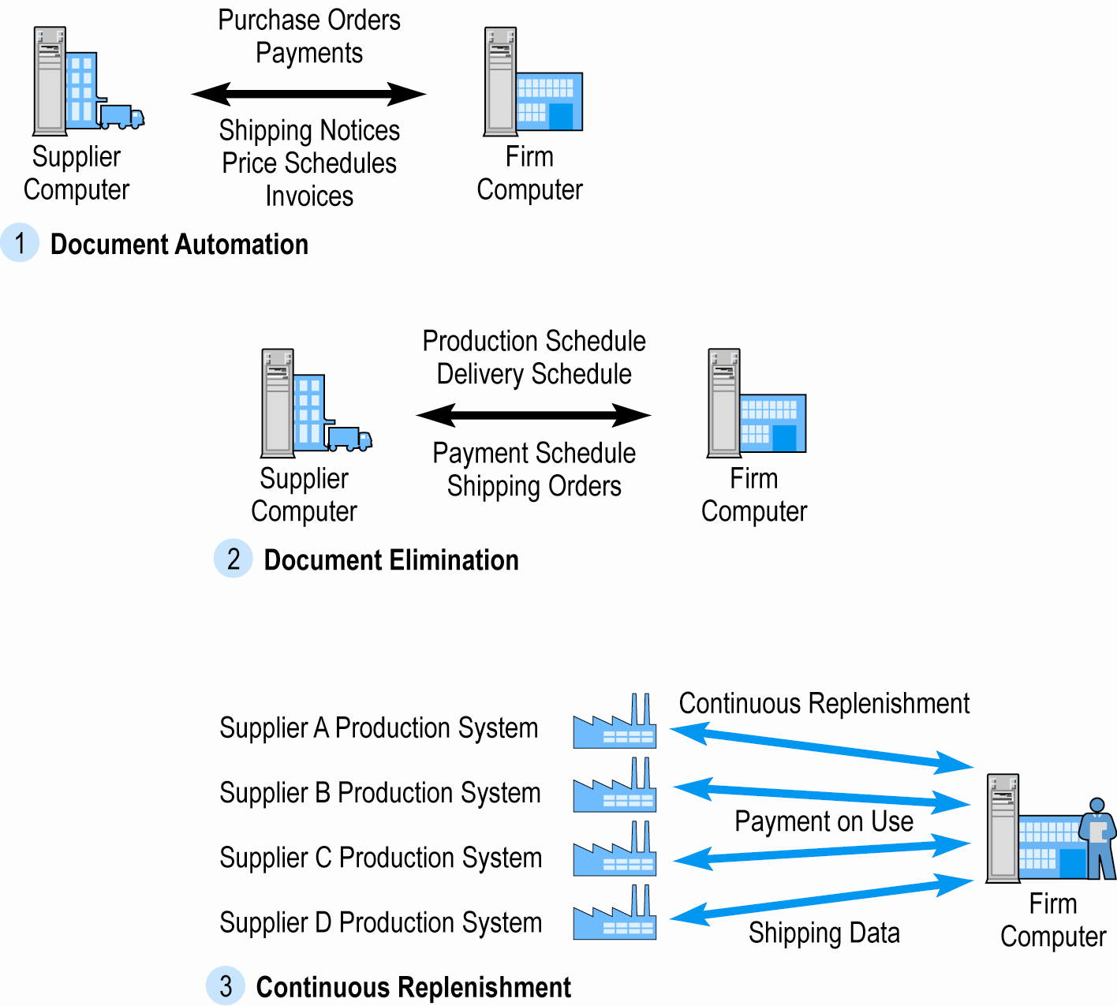
The Evolution of EDI as a B2B Medium

Slide 19
Supply Chain Management Systems
Continuously link activities of buying, making, and moving products from suppliers to purchasing firms
Integrates demand side of business equation by including order entry system in the process
With SCM system and continuous replenishment, inventory is eliminated and production begins only when order is received
Hewlett Packard’s SCM system: elapsed time from order entry to shipping PC is 48 hours.

Slide 20
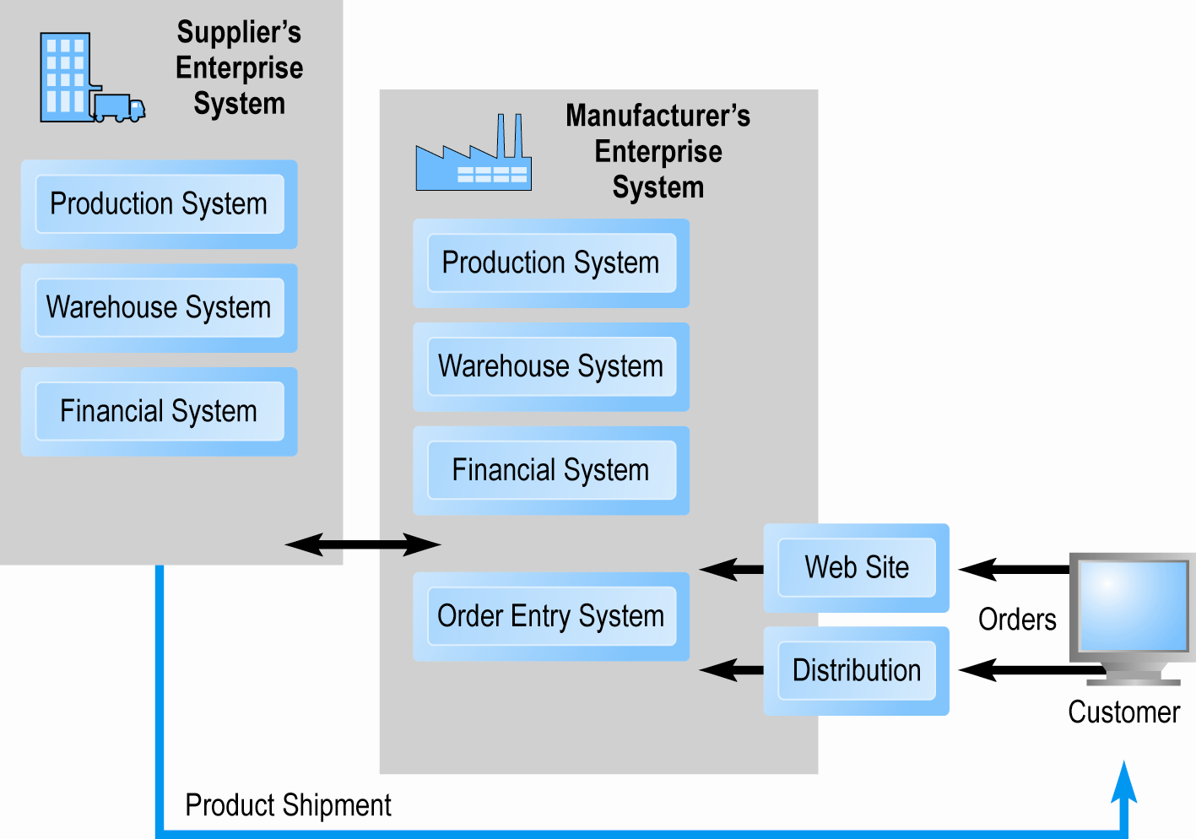
Supply Chain Management Systems

Slide 21
Two Main Types of Internet-Based B2B Commerce
Net marketplaces:
Bring together potentially thousands of sellers and buyers in single digital marketplace operated over Internet
Transaction-based
Support many-to-many as well as one-to-many relationships
Private industrial networks:
Bring together small number of strategic business partner firms that collaborate to develop highly efficient supply chains
Relationship-based
Support many-to-one and many-to-few relationships
Largest form of B2B e-commerce

Slide 22
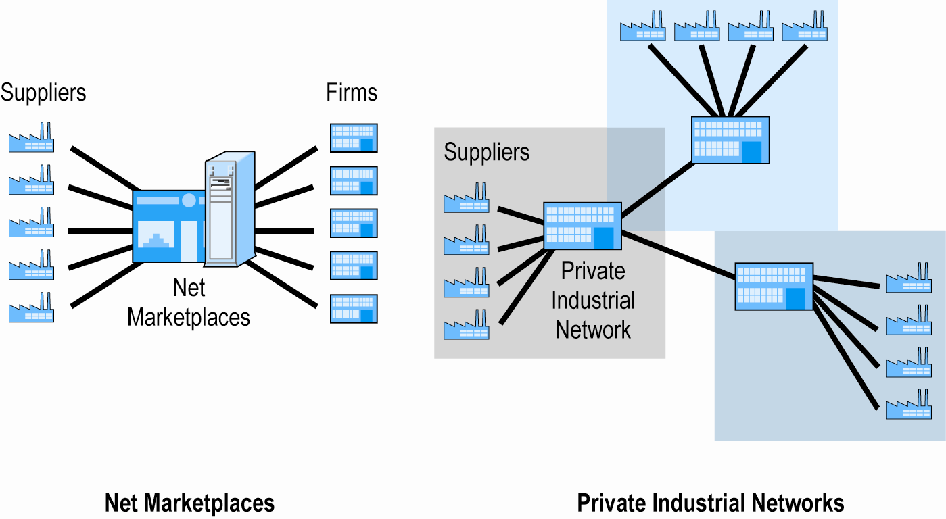
Two Main Types of Internet-Based B2B Commerce

Slide 23
Net Marketplaces
Various ways to classify Net marketplaces:
Pricing mechanism, nature of market served, ownership
By business functionality
What businesses buy (direct vs. indirect goods)
How business buy (spot purchasing vs. long-term sourcing)
Four main types
E-distributors
E-procurement networks
Exchanges
Industry consortia

Slide 24
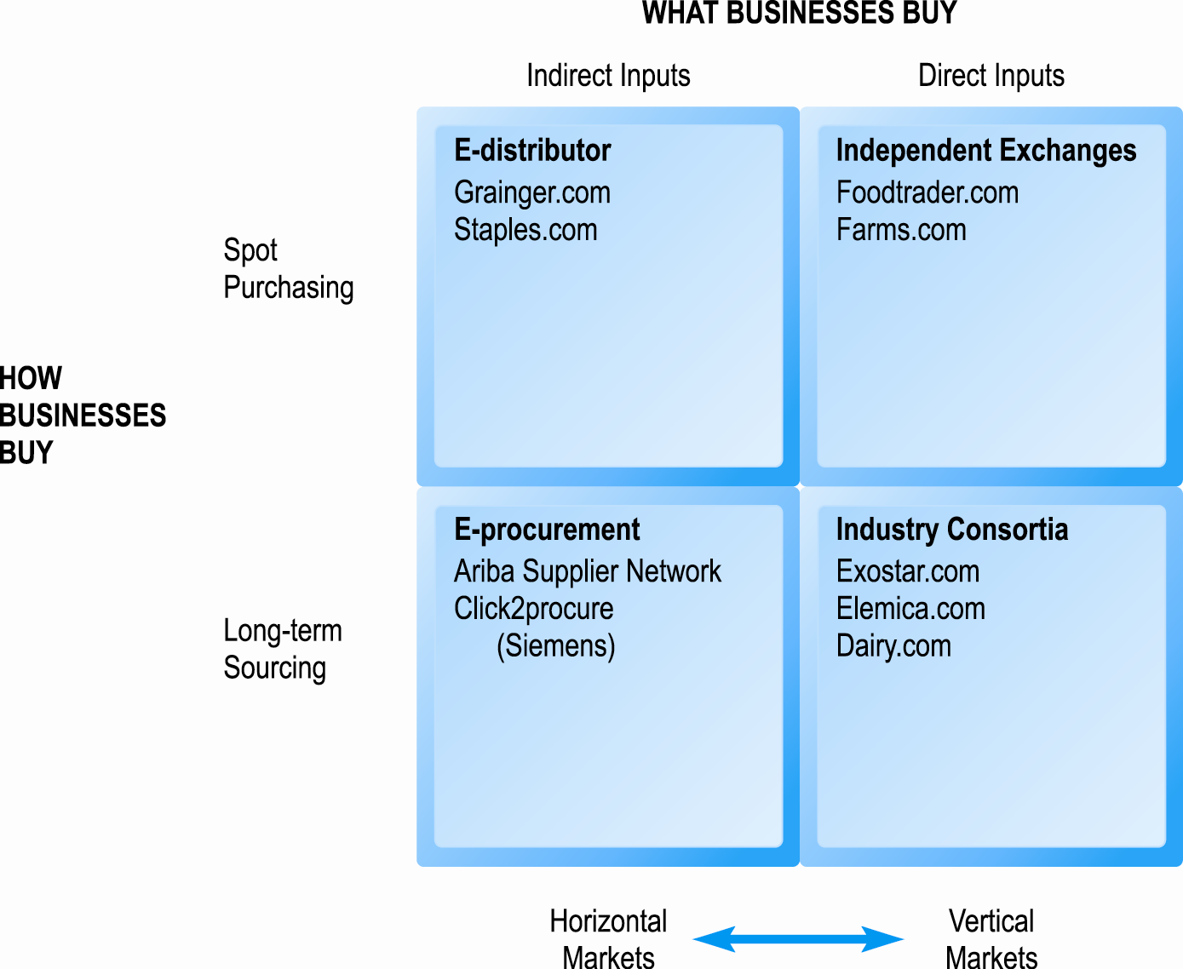
Pure Types of Net Marketplaces

Slide 25
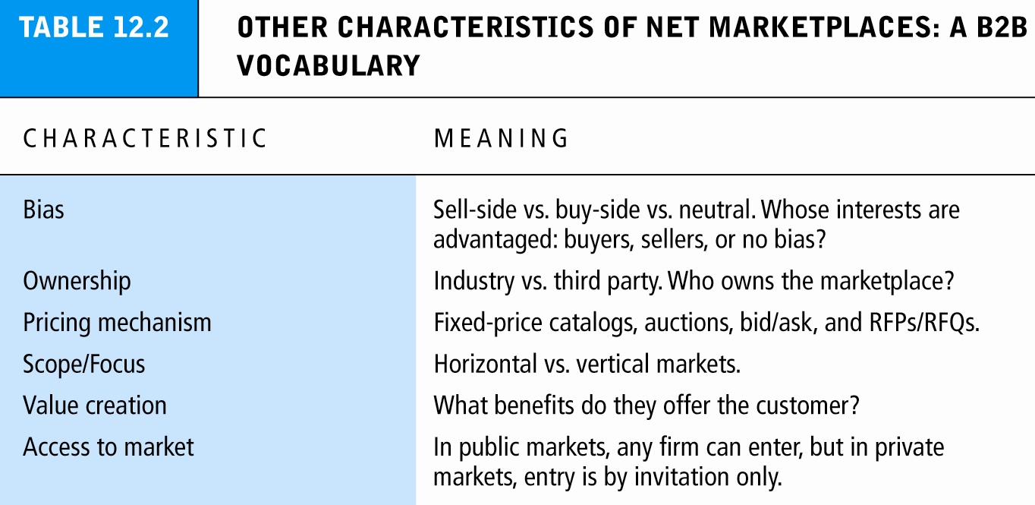

Slide 26
Private Industrial Networks
Private trading exchanges (PTXs)
Web-enabled networks for coordination of trans-organizational business processes (collaborative commerce)
Direct descendant of EDI; closely tied to ERP systems
Typically involve manufacturing and support industries
Typically center around single, very large manufacturing firm that sponsors network
Range in scope from single firm to entire industry
Example: Procter & Gamble

Slide 27
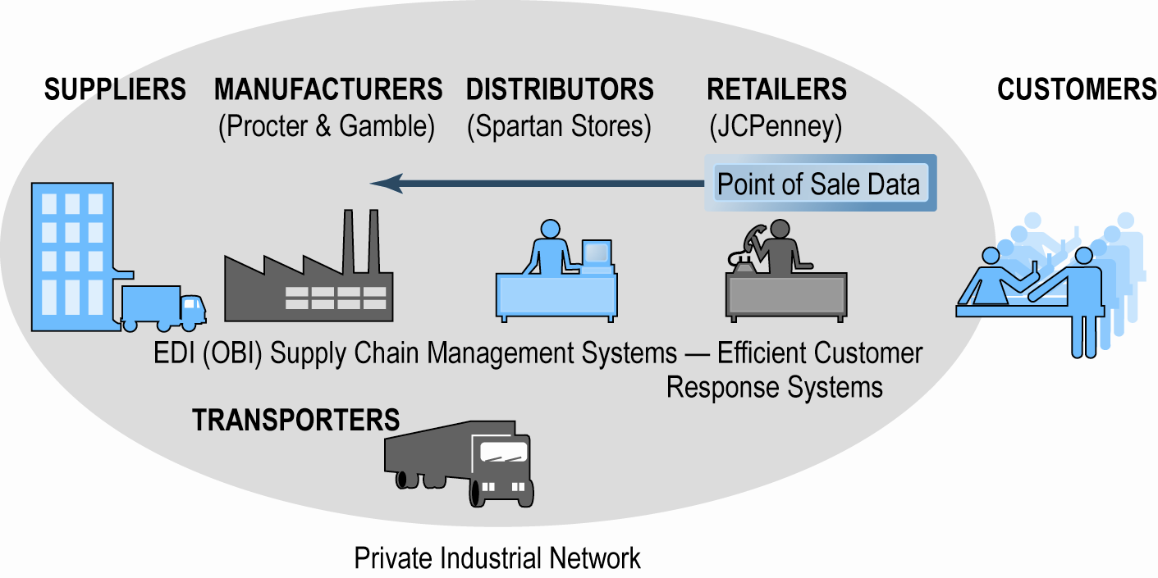
Procter & Gamble’s Private Industrial Network

Slide 28
Characteristics of Private Industrial Networks
Objectives include:
Efficient purchasing and selling business processes industry-wide
Industry-wide resource planning to supplement enterprise-wide resource planning
Increasing supply chain visibility
Closer buyer–supplier relationships
Operating on global scale
Reducing industry risk by preventing imbalances of supply and demand
Focus on continuous business process coordination
Typically focus on single sponsoring company that “owns” the network

